Slide 1
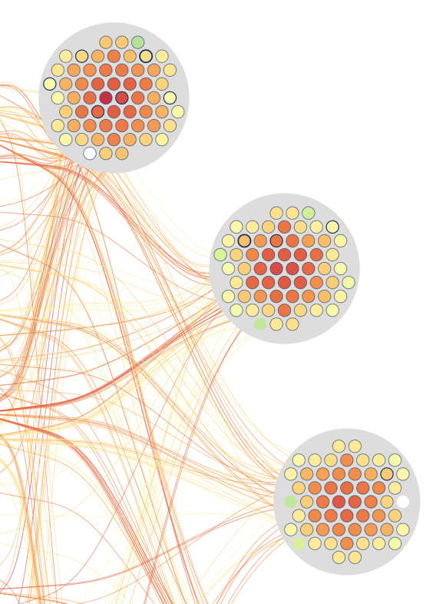
Visualization tools
Summary report

Slide 2
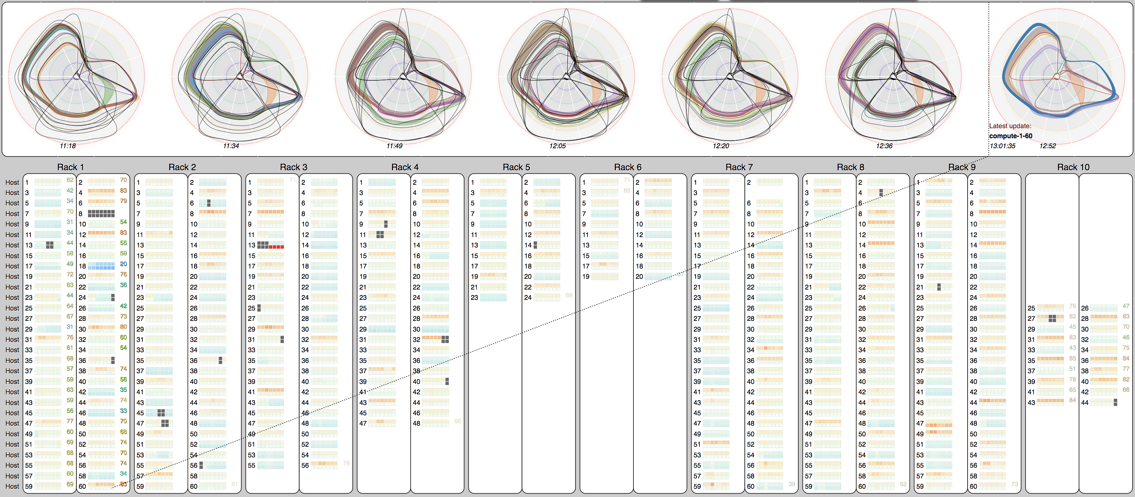
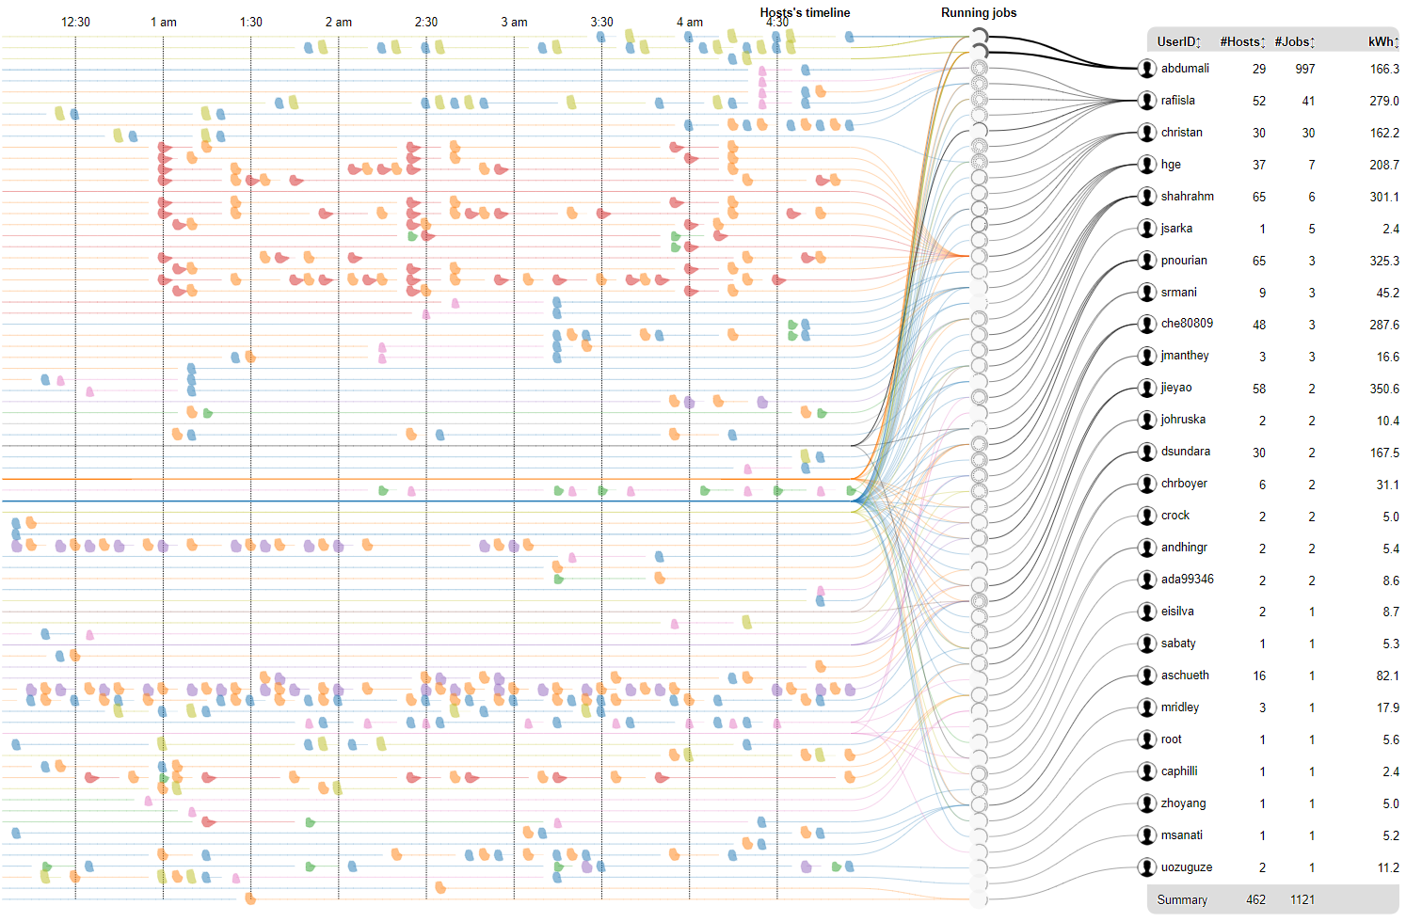
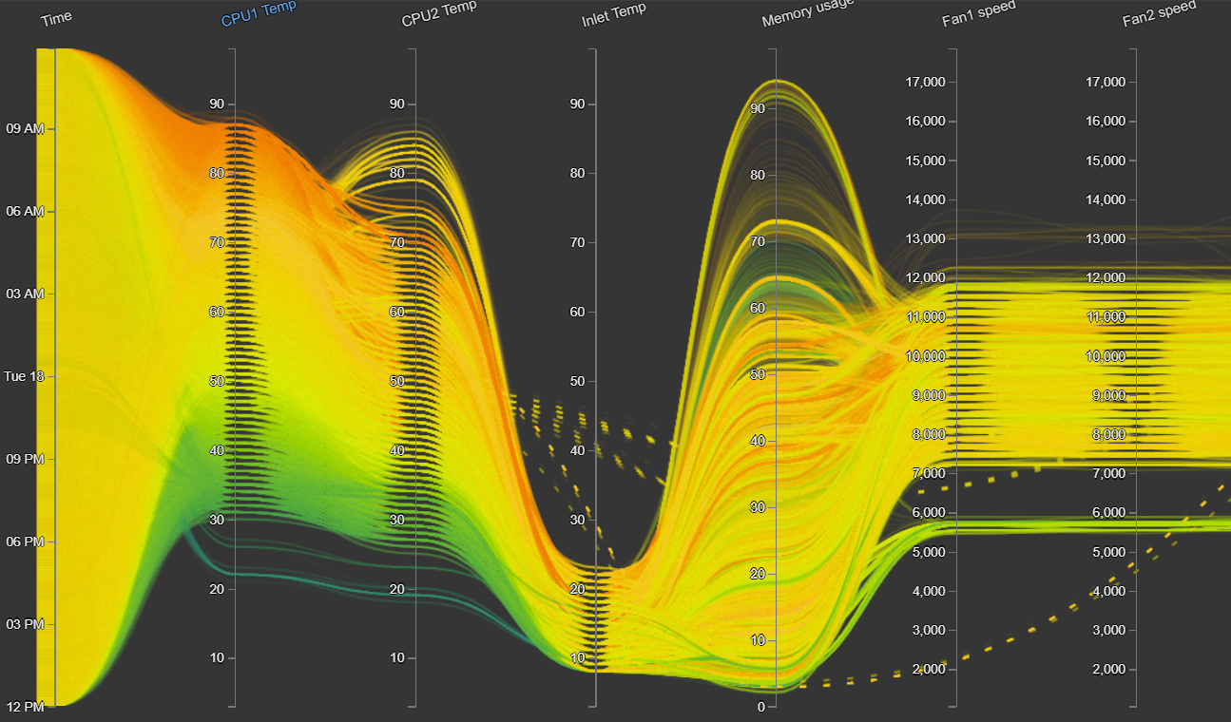
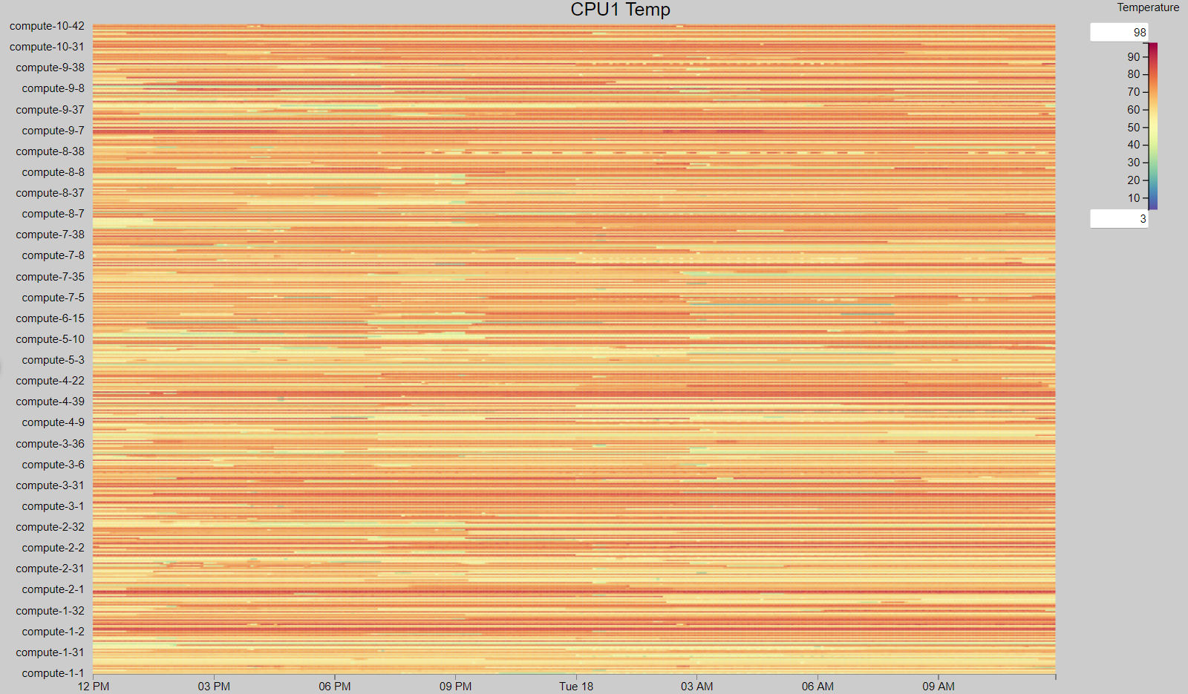
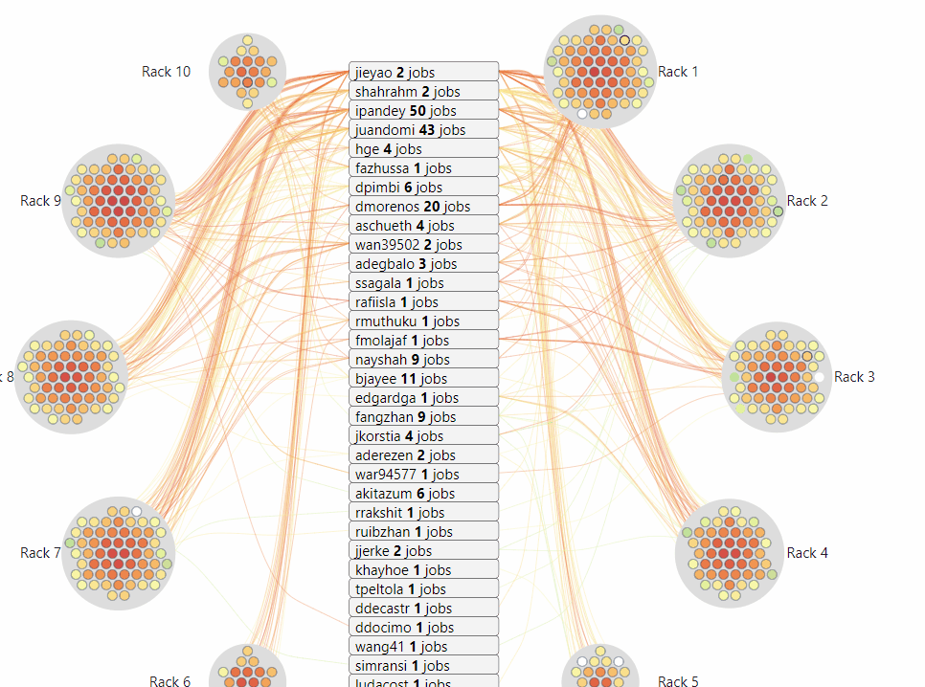
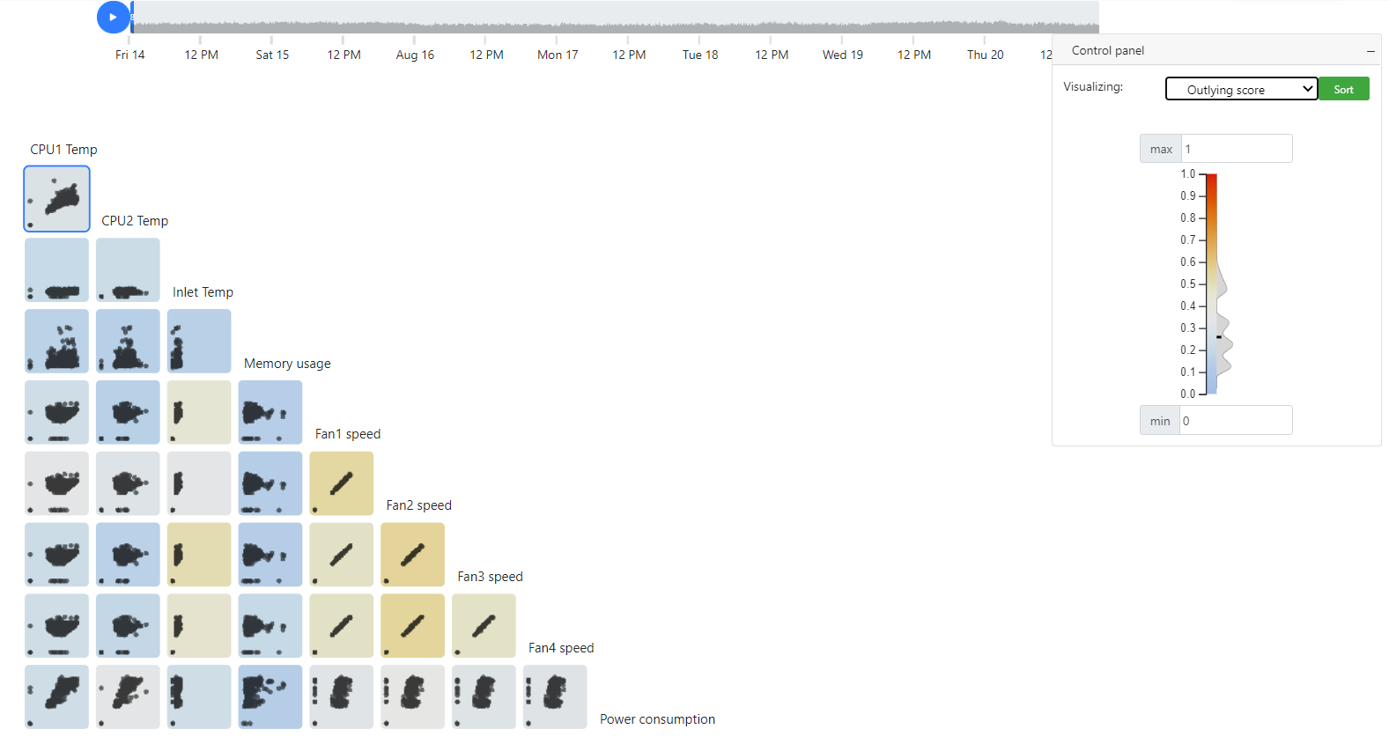
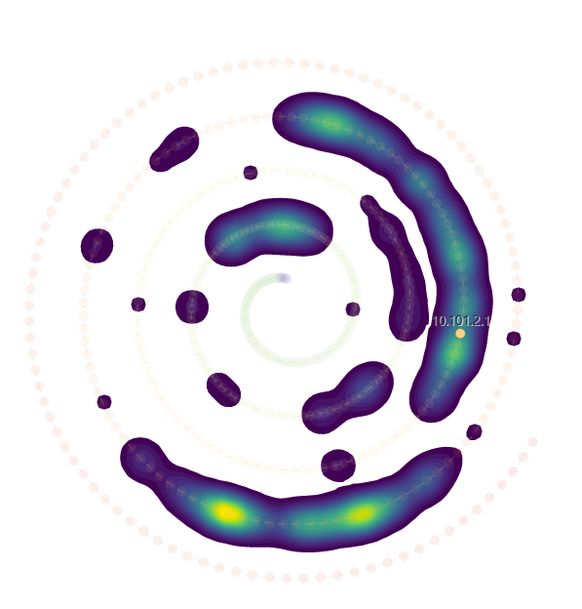
Gallery
Hiperview
TimeRadar
ParallelCoordinates
Heatmap
JobViewer
Scagnostics Viewer
Spiral Layout

Slide 3
https://idatavisualizationlab.github.io/HPCC/HiperView/demo.html
Hiperview
Real-time supported
Pros:
Display physical layout
Time data is encoded in the sequence of heat map cell
Radar chart summary bundle every timestep
Cons:
Limit timestep display
Visualization supported:
Heatmap
Area chart
Radar chart
Box plot
Dynamic t-SNE

Slide 4
https://idatavisualizationlab.github.io/HPCC/TimeRadar/
TimeRadar
MONSTER API
Pros:
System overview and time series information in one visualization
Provide simple and focus view (only display radar when group has changed)
Cons:
Depend on grouping method
User need introduction before using this visualization
Visualization supported:
Radar chart
Time Radar
Line chart
PCA
t-SNE
UMAP

Slide 5
https://idatavisualizationlab.github.io/HPCC/ParallelCoordinates/index.html
ParallelCoordinates
Pros:
Capture System status
show all range of individual metric
All metrics visible
Cons:
Lack of physical information
Hard to follow the status of single node
Need more space for if increase the number of metrics
heavy render time - application slow down when the number of node and time-step increase
Visualization supported:
Parallel coordinate
Violin plot
Stack stream

Slide 6
https://idatavisualizationlab.github.io/HPCC/heatmap/
Heatmap
MONSTER API
Pros:
Capture System status
show all range of individual metric
All metrics visible
Fast rendering
Cons:
Lack of physical information
Visualization supported:
Heatmap

Slide 7
https://idatavisualizationlab.github.io/HPCC/jobviewer/index.html
JobViewer
Real-time supported
MONSTER API
Pros:
Capture System status
Clear snapshot of single metric
User , job and compute relationship
Cons:
Lack of physical information
Lack of entire time range illustration
Visualization supported:
Radar chart
Circle parking

Slide 8
https://idatavisualizationlab.github.io/HPCC/scagnosticsViewer/index.html
Scagnostics Viewer
Real-time supported
MONSTER API
Pros:
Capture System status
All metrics available
Cons:
Not common features (scagnostics)
Lack of physical information
Lack of entire time range illustration
Visualization supported:
Scatter plot
Area chart
Violin plot

Slide 9
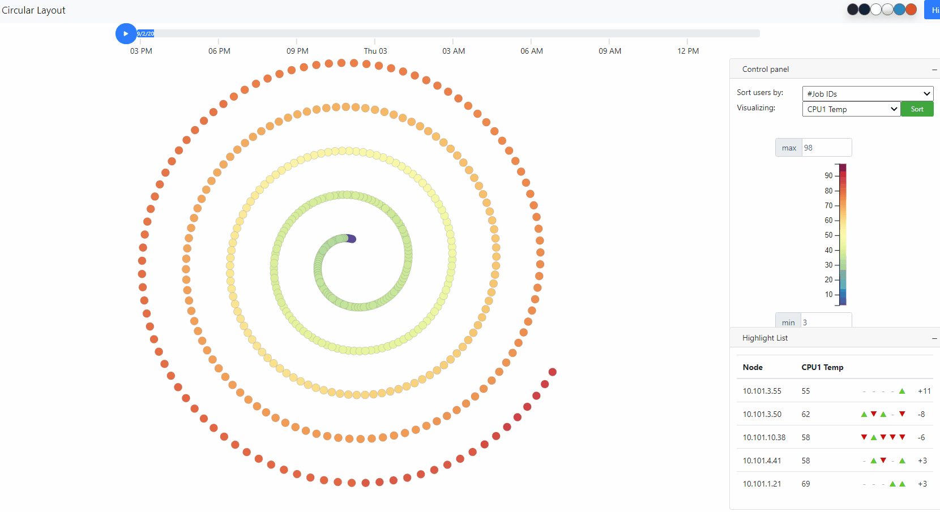
https://idatavisualizationlab.github.io/HPCC/spiralLayout/index.html
Spiral Layout
Real-time supported
MONSTER API
Pros:
Capture System status
Snapshot of single metric
Highlight trajectory of entire time range of single compute
Cons:
Lack of physical information
Visualization supported:
Radar chart
Circular layout
Density Contour

Slide 10
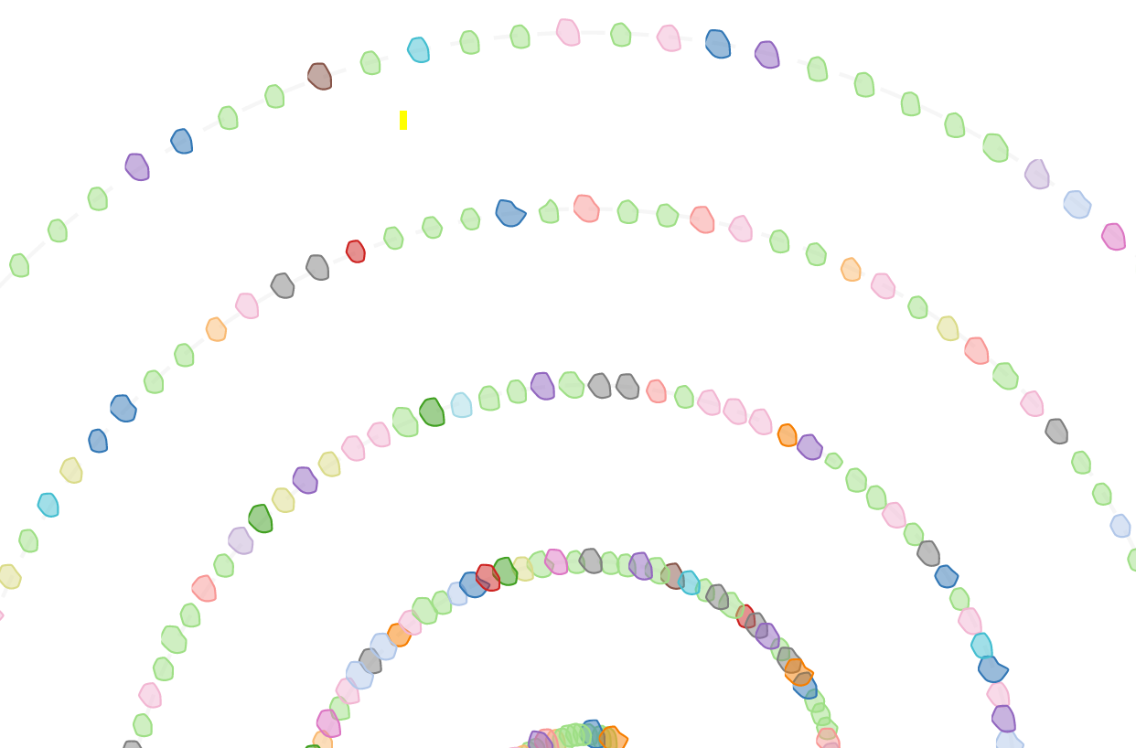
Demo

Slide 11
Thank you for your attention

